Slide 1
When will you have an accident?
Notes:
When will YOU have an accident?
A challenging and harsh question we almost don’t dare to ask.
It is impossible to know and to predict!
That's precisely why you require our expertise!
Kevin D

Slide 2
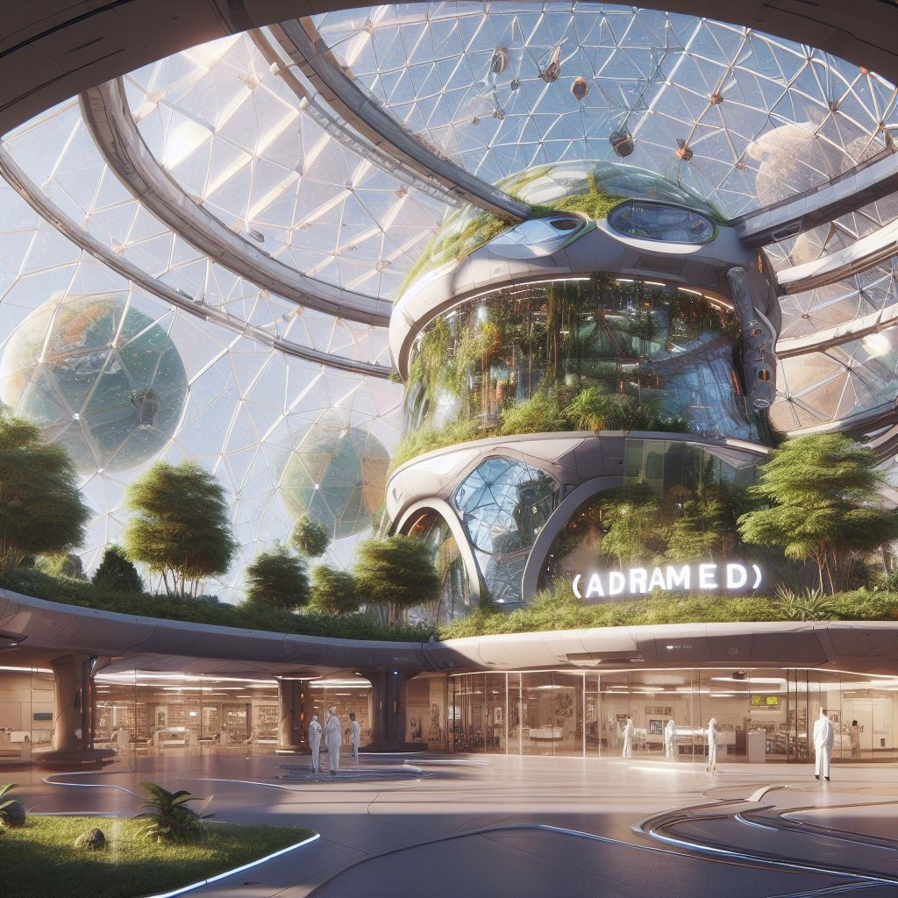








Notes:
So Welcome, everyone, to AdraMed!
Kevin D

Slide 3
Revolutionizing Health with ResQ
Welcome to
Notes:
We're thrilled to take you on a journey through AdraMed and our groundbreaking product, ResQ.
Get ready to witness a transformation in health & wellness like never before.
Kevin D

Slide 4

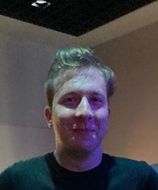
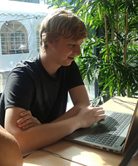
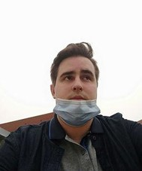


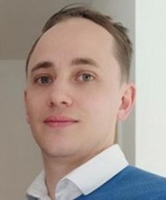
Our Team
Kevin Henri
Ties Verhé
Vincent Van Zele
Kevin Demeulenaere
Bram Lahousse
Notes:
We will start with a short introduction of our Team.
Kevin Henri: Risk & Security Manager
Ties Verhé: Network & Server Manager
Vincent Van Zele: CEO & AVA Designer
Bram Lahousse: R&D Manager
Kevin Demeulenaere: Quality Control & Marketing Manager

Slide 5

AI health assistant
Where do you stand on AI?
Notes:
Before we continue we would like to know:
Where do you stand on AI?
In our opinion AI is a technology that can do many things that humans can do, but faster and better. AI can help us with many problems, but it can also cause some problems. AI should be used wisely and ethically, and work with us, not against us.
Kevin D

Slide 6


Vision and Mission
Our Vision for Health & Wellness, Our Mission with ResQ
Connected Wellness and Health
Data-Driven Insights
Artificial Intelligence Innovation
Collaborative Partnerships
Healthier Future
Notes:
At AdraMed, we envision a future where Health & Wellness are accessible for everyone. We want our product to connect people and be proactive.
We use our product ResQ to transform health care with innovative solutions that saves lives.
Kevin D

Slide 7
Vision and Mission
Our Vision for Health & Wellness, Our Mission with ResQ
Connected Wellness and Health
Notes:
We want to create an interplanetary connected ecosystem where individuals can proactively manage and enhance their well-being.
Kevin D

Slide 8
Vision and Mission
Our Vision for Health & Wellness, Our Mission with ResQ
Connected Wellness and Health
Data-Driven Insights
Notes:
This is done with the help of our Data driven approach, allowing us to provide valuable and personalized insights, enabling informed decision-making and proactive health management.
Kevin D

Slide 9
Vision and Mission
Our Vision for Health & Wellness, Our Mission with ResQ
Connected Wellness and Health
Data-Driven Insights
Artificial Intelligence Innovation
Notes:
We lead the industry in innovation and technology with AvA, our Advanced Virtual Aid assistant, driven by Artificial Intelligence.
Kevin D

Slide 10
Vision and Mission
Our Vision for Health & Wellness, Our Mission with ResQ
Connected Wellness and Health
Data-Driven Insights
Artificial Intelligence Innovation
Collaborative Partnerships
Notes:
And with the help of collaborative partnerships, we commit to continuous evolution, staying at the forefront of health and wellness.
Kevin D

Slide 11
Vision and Mission
Our Vision for Health & Wellness, Our Mission with ResQ
Connected Wellness and Health
Data-Driven Insights
Artificial Intelligence Innovation
Collaborative Partnerships
Healthier Future
Notes:
We basically envision a better future where AdraMed plays a pivotal role in building healthier and happier communities around the universe.
Kevin D

Slide 12
Demographics, trends, and competitive landscape
Market Overview
Geographical Reach:
Age Group:
Young Adults (19 – 26)
Seniors (63 – 76)
Adria
Mars
Outer-Space
Notes:
Ladies and gentlemen, let's dive into the market landscape.
Understanding our audience is key.
Our demographics analysis has revealed a diverse user base, spanning various age groups and geographic locations. In terms of age distribution, we've observed significant engagement from the age groups 19-26 and 67-74, showcasing a strong appeal to the young adult demographic. Geographically, our users are spread across all colonies and beyond, indicating a wide interest in our health and wellness solutions.
Current trends indicate a growing demand for connected health solutions, aligning perfectly with our mission. Now, in terms of competition, we've identified that nobody offers the simplicity and accuracy of our product which makes our product, ResQ, stands out.
Kevin H

Slide 13
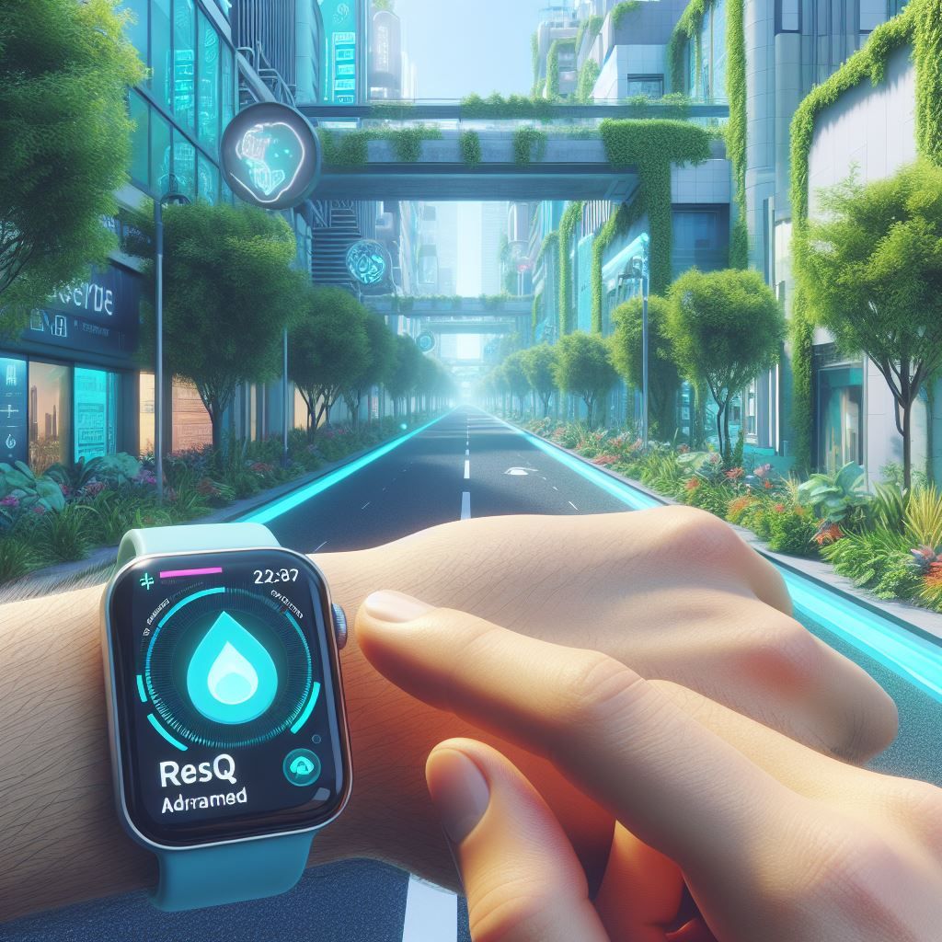
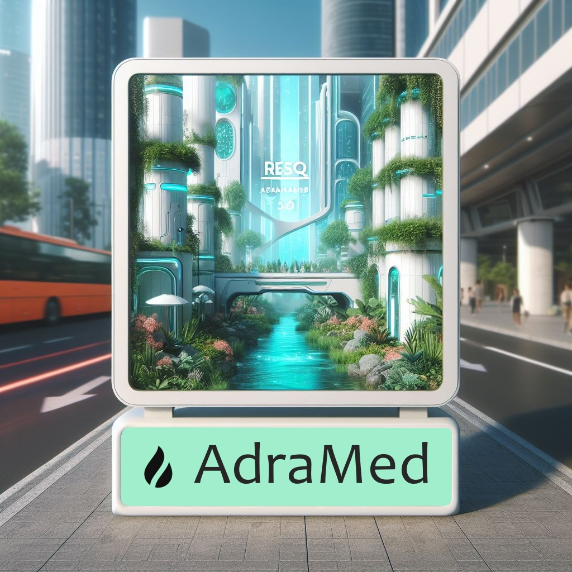
Channels, campaigns, and strategies for user acquisition
Market Plan
Notes:
Let's unveil our marketing strategy.
We've carefully selected channels that resonate with our audience, such as in and out app advertisement, but we trust that the usefulness of our product will advertise itself.
Our upcoming campaigns are designed to drive user acquisition and create a lasting impact.
Kevin H

Slide 14



Explore the ResQ Ecosystem
ResQ
Notes:
This is the ResQ ecosystem, where the Adria wristband, our AI AvA, and our vibrant user community come together to create a holistic approach to Health & Wellness.
On top of our core health features, we provide premium users with travel preparation guidances, wellness coaches or even community achievements, all leading to better engagement towards our product.
It's more than a product; it's a lifestyle and this is reflected in our user statistics.
Bram

Slide 15
20% of 1st year’s costs <=> 1.500.000 Adria Coins
Funding
ResQ
Advertisement | AvA Development | Infrastructure
250.000 Adria coins | 750.000 Adria coins | 500.000 Adria coins
5 % Return on Investment
Notes:
While we are confident in the success of our product, we recognize that strategic investment can further accelerate our growth.
We are seeking approximately 20% of our first-year costs as an investment, which amounts to 1 million and a half Adria Coins. This funding will be strategically utilized to limit our inital costs in the first year and avoid going to far in the red.
Bram

Slide 16
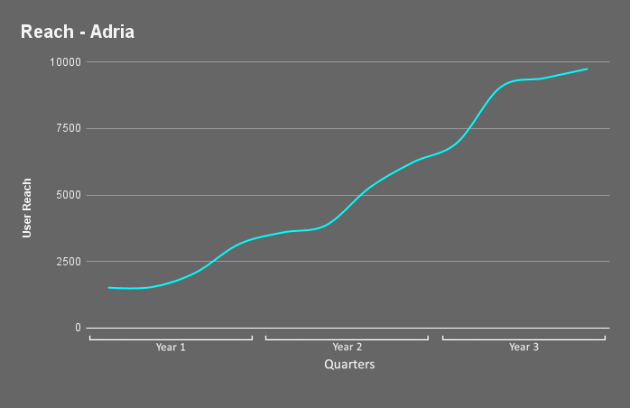
Connecting Communities: User Reach and Growth
User Reach and Growth
Notes:
Watch as we showcase the continuous growth in ResQ users over time.
ResQ isn't just a product; it's a movement that's connecting individuals and communities worldwide and beyond.
As seen in these graphics, Adria as a steady user reach and growth as the colony is in dire shape. As for Mars, our user count really starts to grow after the second year, when our product is really implanted in the colony.
We can elucidate this user base by ensuring that our solutions are inclusive, feature an affordable subscription model, and are tailored to diverse needs.
Bram

Slide 17
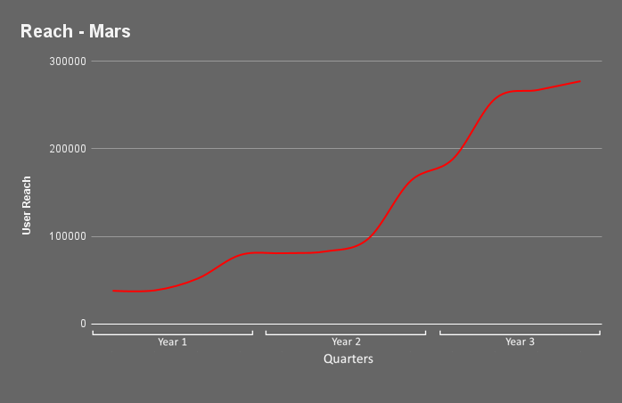
Connecting Communities: User Reach and Growth
User Reach and Growth
Notes:
Watch as we showcase the continuous growth in ResQ users over time.
ResQ isn't just a product; it's a movement that's connecting individuals and communities worldwide and beyond.
As seen in these graphics, Adria as a steady user reach and growth as the colony is in dire shape. As for Mars, our user count really starts to grow after the second year, when our product is really implanted in the colony.
We can elucidate this user base by ensuring that our solutions are inclusive, feature an affordable subscription model, and are tailored to diverse needs.
Bram

Slide 18
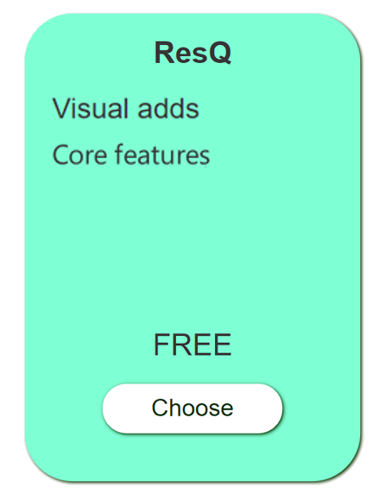
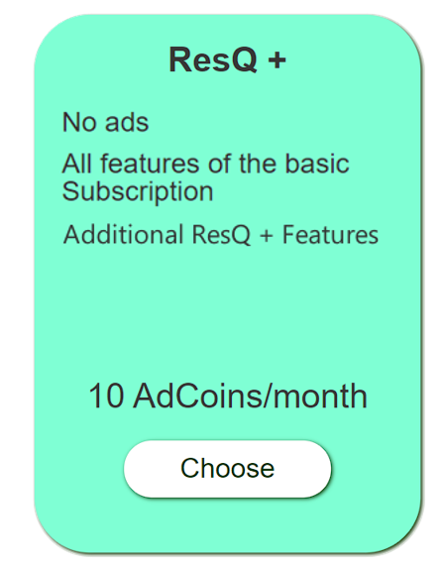
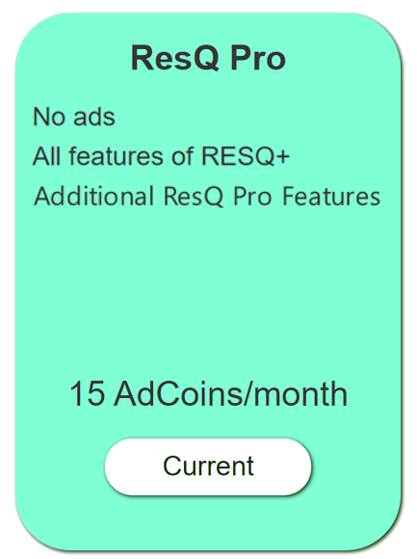
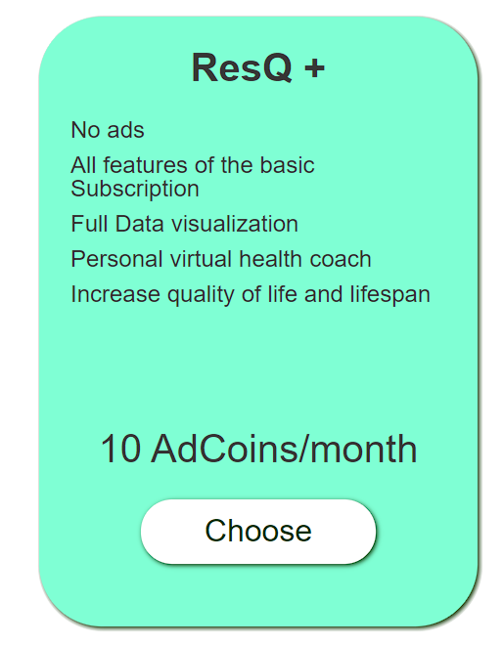
Unlocking Wellness: ResQ Subscription Models
Subscription Model
Notes:
ResQ’s subscription plans include: ResQ, ResQ+, and ResQ Pro.
Each plan offers unique features designed to cater to different wellness needs.
Choose the plan that fits your lifestyle.
Our three-tiered subscription model ensures a steady stream of revenue, including the freemium plan, which provides users access to essential features while incorporating additional advertisements.
Bram

Slide 19


Strategic Partnerships
Building a Future: Evolutionary Partnerships
Notes:
Supporting our vision are valuable collaborators and partnerships, with TerraNex and Lenus standing out as our primary partner companies that utilize our product.
Additionally, our engagements with the government and other data-driven entities, given the valuable intel our data holds, contribute significantly to our profit, providing a clear boost to our financial success.
Bram

Slide 20
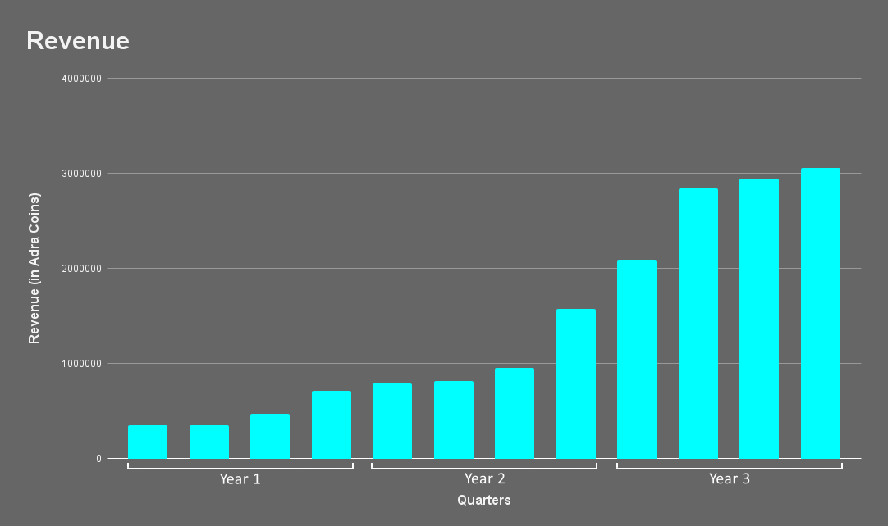
Revenue Generation
Notes:
All of this means that ResQ isn't just a product.
From our point of view, it’s also a sustainable business model.
With this chart, explore the various revenue streams, from subscription fees to data licensing and strategic partnerships, driving ResQ's success.
The presented charts illustrate our extensive user base and substantial revenue streams, underscoring the enormous financial investment required to initiate our project.
Vincent

Slide 21
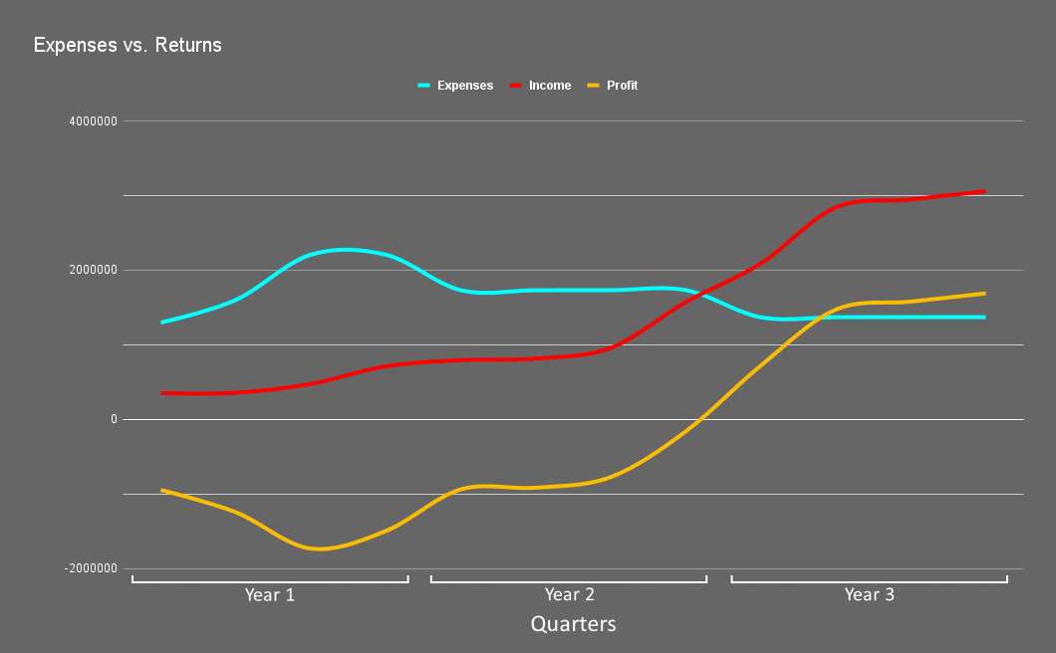
Profit & Loss Overview
Notes:
Take a closer look at the projected expenses, incomes and profit overview.
Given the initial financial demands, we took a gamble by refraining from seeking external funds. This not only grants us complete independence but also ensures that our profits soar as we expand our user reach.
While it is a risky move, we are confident that our product will achieve self-sufficiency by the end of the second business year.
Vincent

Slide 22
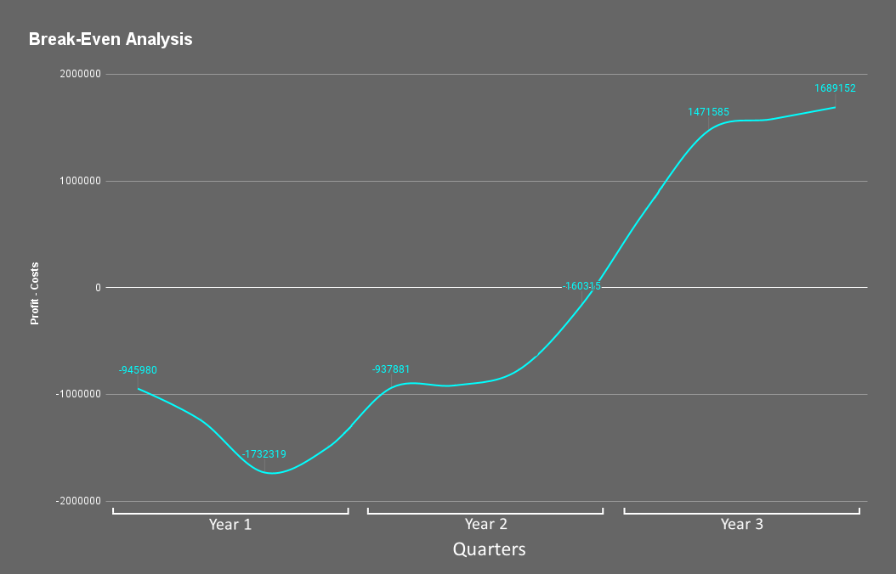
Strategic Milestone: Achieving Break-Even
Break-Even Analysis
Break - Even is achieved when our user count reaches approximately:
186 000 users
Notes:
This can be seen in our Break-Even analysis. Witness the strategic milestone where ResQ's revenue equals costs.
It's a testament to ResQ's sustainability and growth potential.
Our profits begin to soar in the middle of the second business year, and we achieve break-even by the year's end, or, to put it differently, when our user count reaches 186,000 users.
Vincent

Slide 23
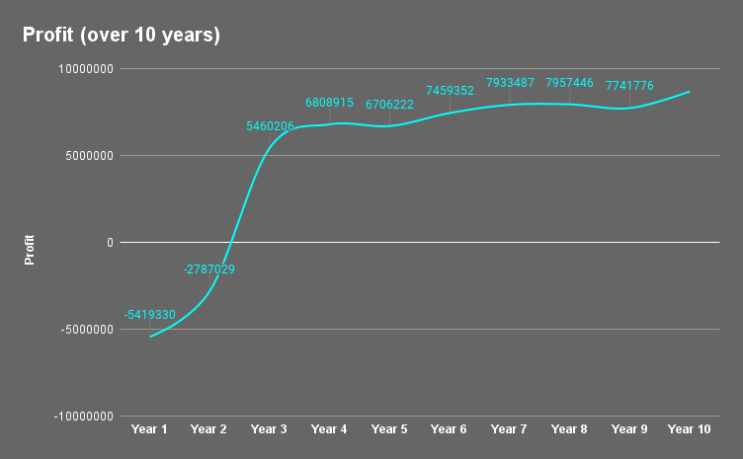

Tomorrow's Wellness, Today's Vision
Future Vision
Notes:
As we wrap up the financial segment of our presentation, let's take a glimpse into the future of AdraMed & ResQ.
ResQ marks the initial steps in a journey toward a healthier and interconnected universe. Over the next decade, ResQ is projected to be highly profitable, eliminating the need for frequent application updates.
This, in turn, will afford us the opportunity to channel resources into other projects on every Human colonies, all benefiting from the profits generated by ResQ.
I’ll now let our Security manager talk about our Emergency Response Strategies.
Vincent

Slide 24
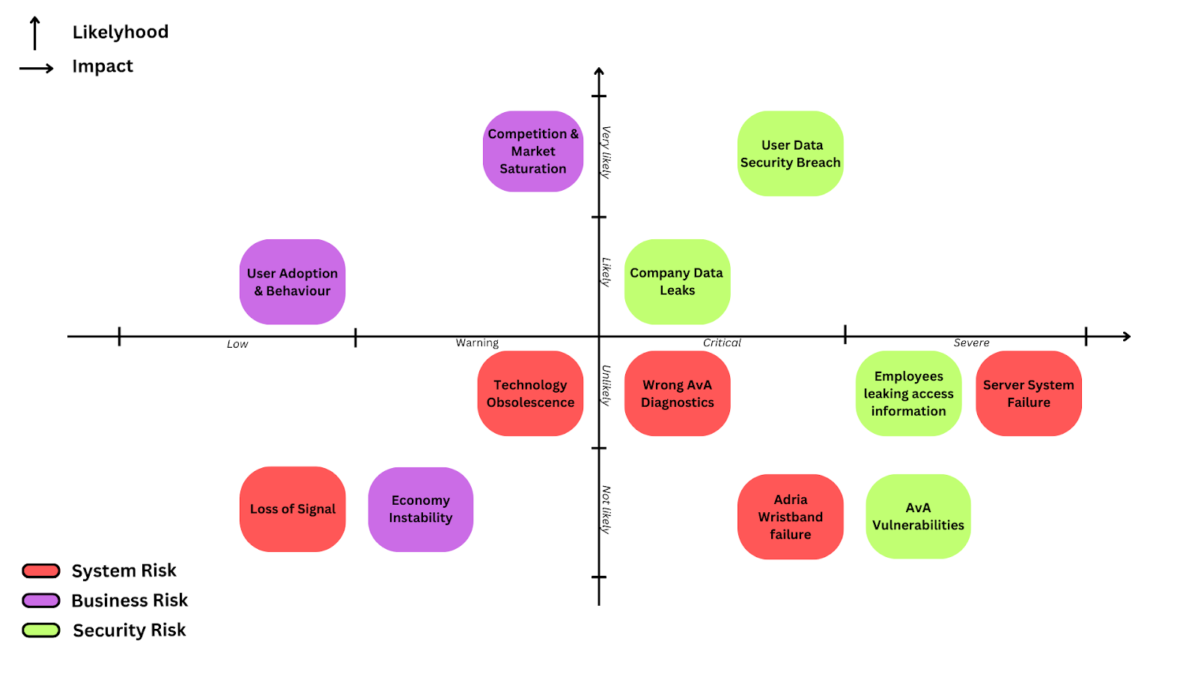
Risk Analysis
Emergency Response Strategy
Notes:
Moving forward, we must acknowledge potential risks.
Market dynamics can be unpredictable, and we've considered every risk mentioned in this slide.
These risks can go from System Risks with different system failures & obsolescence, Business Risks considering the current market saturation & economy stability and, also Security Risks including Data leaks and other vulnerabilities.
But fear not, we've developed robust mitigation strategies to navigate these challenges and ensure a resilient business model.
From quarterly in-house trainings leaded by our emergency team to continuous security updates, we are more than capable to handle any situation.
Kevin H

Slide 25

Demo
Notes:
We will now showcase our product to offer you a comprehensive view of what to anticipate when utilizing ResQ.
TIES

Slide 26
20% of 1st year’s costs <=> 1.500.000 Adria Coins
Funding
ResQ
Advertisement | AvA Development | Infrastructure
250.000 Adria coins | 750.000 Adria coins | 500.000 Adria coins
5 % Return on Investment
Notes:
Repeat

Slide 27
Contact us
📧 Email: AdraMed@Adria.com
📶 Tel: 777-immortality-777
🏢 Address: Road to immortality 7
🏙️ City: Adria, Earth
🕸️Website: https://kevinhenri.wixsite.com/home
Notes:
Thank you for your attention and interest in our product. I hope you found it informative and exciting. If you have any questions, comments, or feedback, please feel free to contact us through any of the these channels.
We would love to hear from you and discuss how we can work together to achieve our goals. Thank you again and have a great day.
TIES

Slide 28
any questions ?
any questions ?
any questions ?
Notes:
Thank you for joining us on this journey! We're now open for questions.
TIES

Slide 29
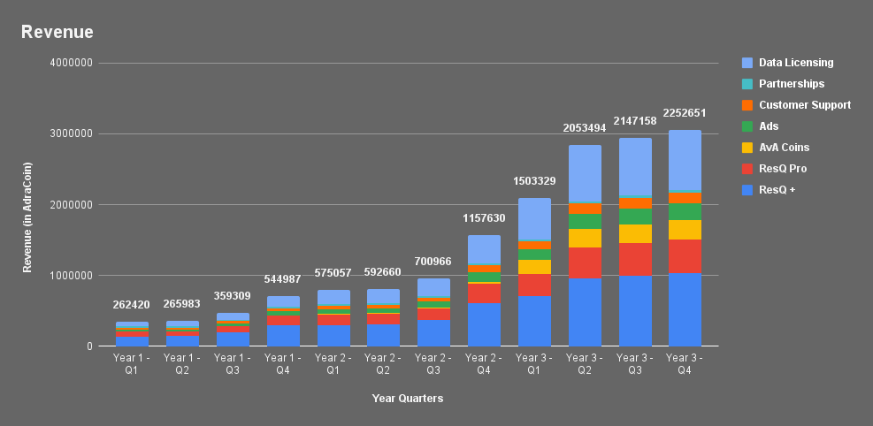
Revenue in details
Additional Slides
Notes:
All of this means that ResQ isn't just a product.
From our point of view, it’s also a sustainable business model.
With this chart, explore the various revenue streams, from subscription fees to data licensing and strategic partnerships, driving ResQ's success.
The presented charts illustrate our extensive user base and substantial revenue streams, underscoring the enormous financial investment required to initiate our project.
Vincent

